Slide 1
Cybercrime in India
Present to Vicky Tao

Slide 2
Our Team
W0862377
Project Document Controller and Content Writer
Handle all documentation part, review all resources and organize all content and build an organized document
Sandeep Kaur
W0859984
Parbhjot Kaur
Researcher and Resource Coordinator
Provide all the sources and references use in project.
W0861930
Sahil
Developer
Handle coding part and make sure all the models properly execute and suitable for provided dataset.
Group Leader
Lead the group by help and guide group members.
Janvi
Developer
Handle coding part and develop all models.
Manish Kataria
W0861408
W0865937
2

Slide 3
Malware Attacks
Online Banking Frauds
Cybercrime
10 - 11
6 - 7
4
8 - 9
5
Structure
Credit/Debit Card
Frauds
Conclusion
13
Content
12
14
Preventive Measures and Solutions
References

Slide 4
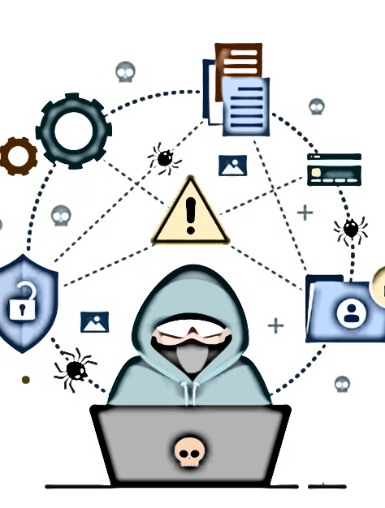
Cybercrime
What
is cybercrime?
Who
are cybercriminals?
How
cybercrime happened?
Why
are Cybercrimes Increasing?
Ways of Cybercrime
Using Computers
Targeting Computers
Types of Cybercrime
Malware Attacks
Credit/Debit Card Frauds
Online Banking Frauds
4

Slide 5
Structure
Data
Historical Overview
Major
Incidents
Reasons
Prediction
Models
Describe our dataset we use in this project
On the base of our dataset describe history of different types of attacks with visualization
Provide details on major incidents.
Explain the reasons behind attacks or frauds.
On the basis of research prediction related to attacks or frauds
Discuss ROC graph of our models for each topic
5

Slide 6
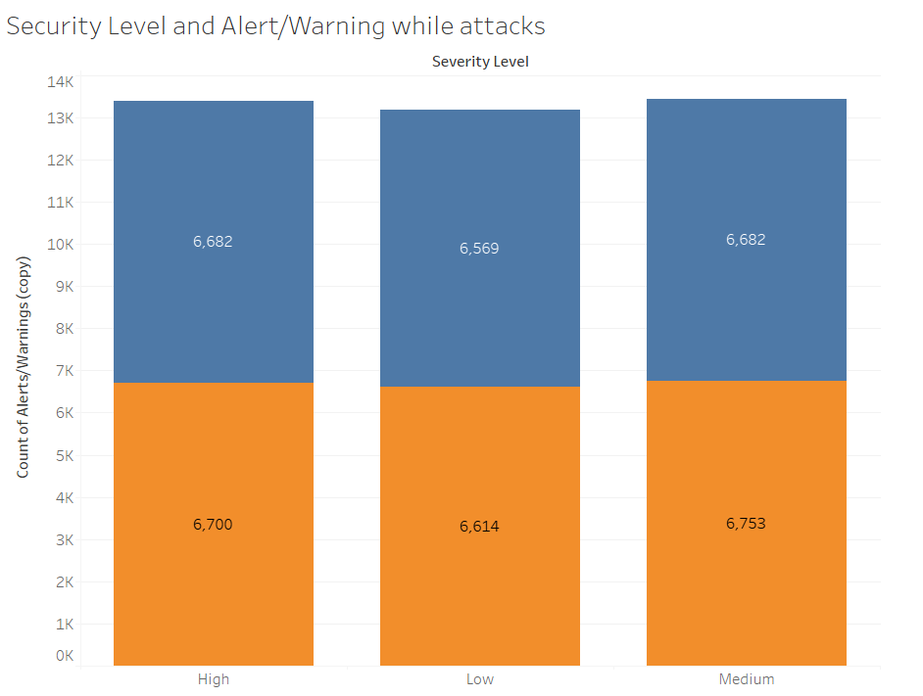
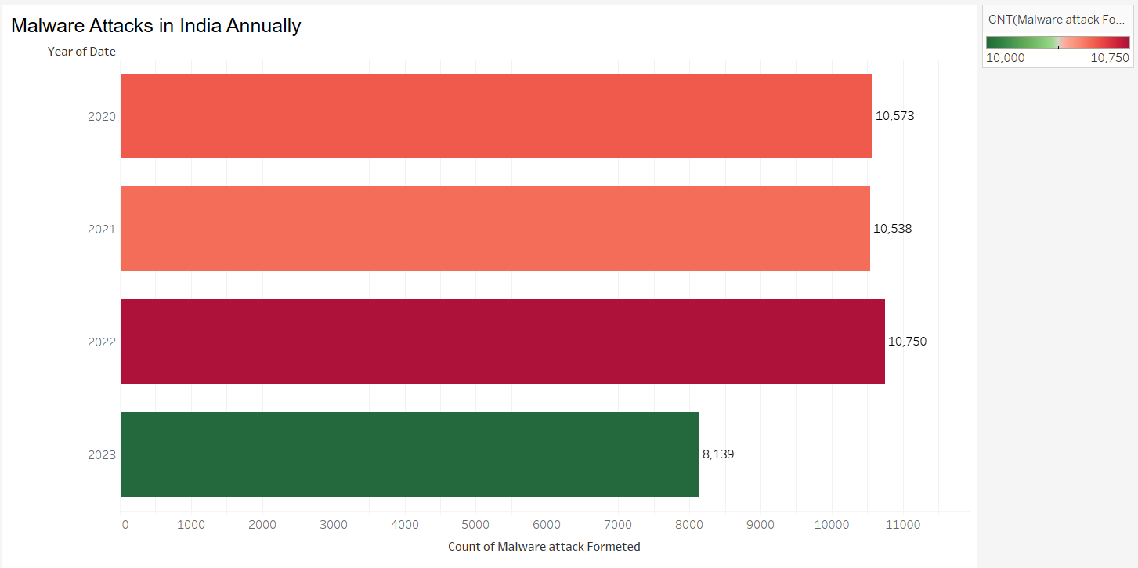
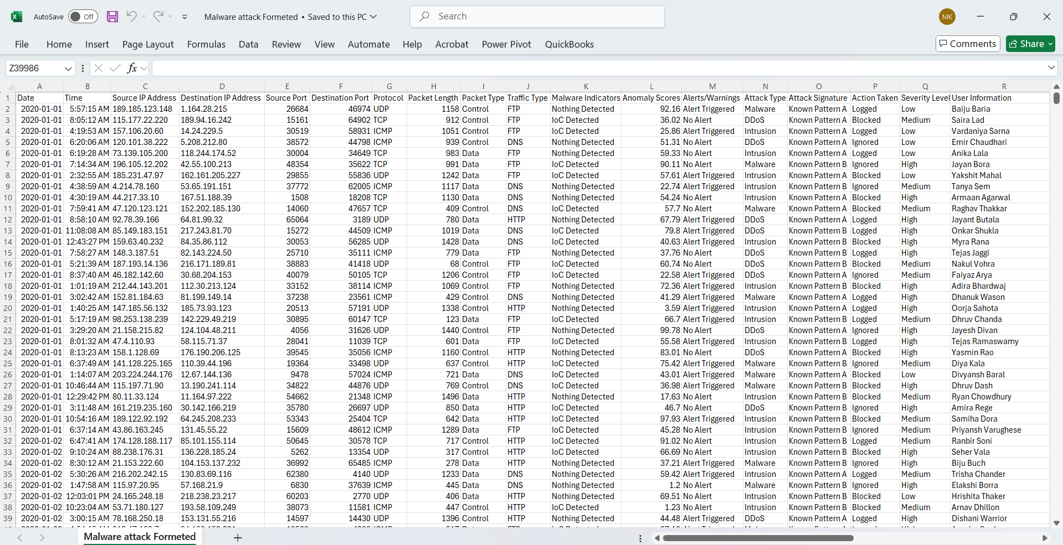
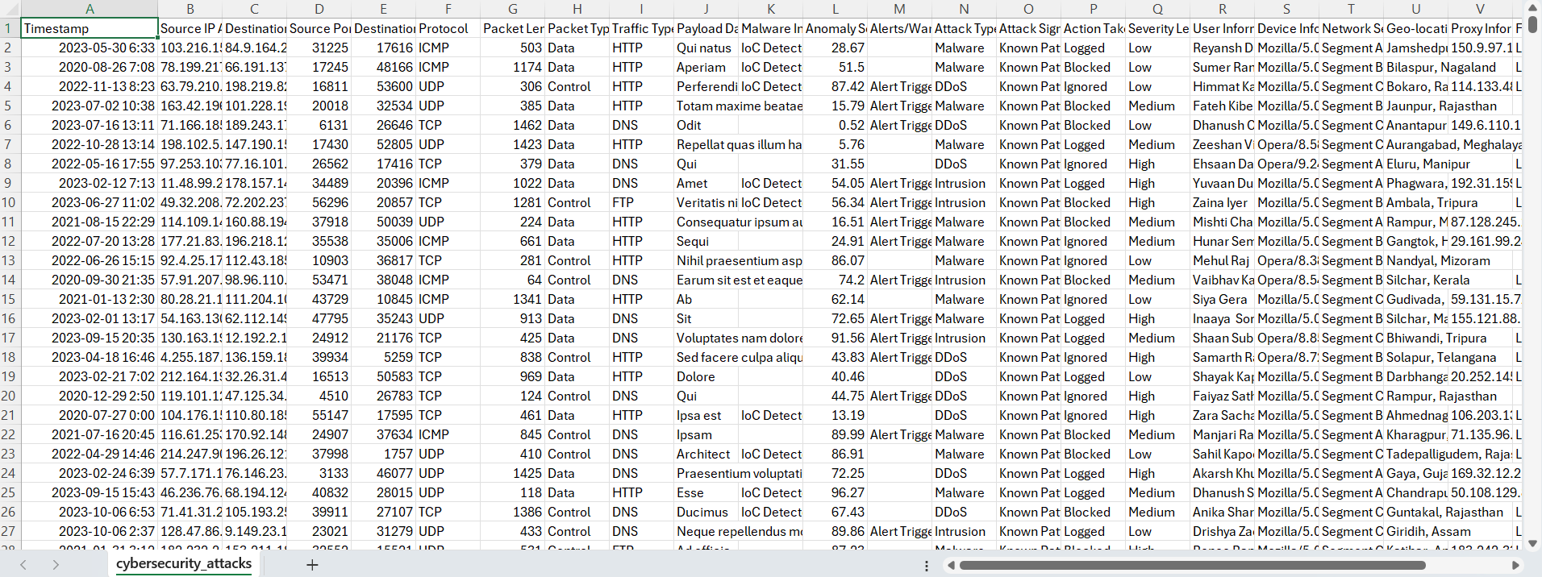
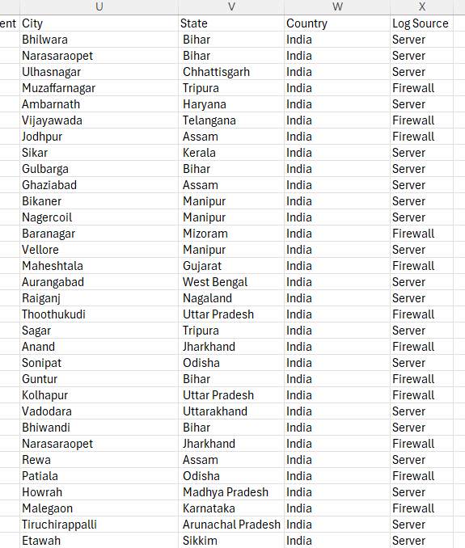
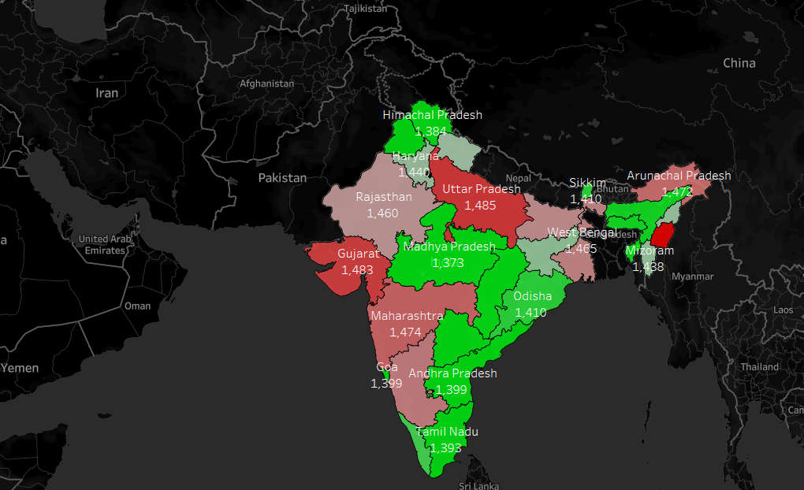
Malware Attacks
Data Overview
Major Incidents
Number of Cases of Malware attacks in Different state
of India
WannaCry (2017)
LockBit (2023)
Akira Ransomware (2023)
History of Malware Attacks in India
?
Reasons
Growing Digital Infrastructure
Weak Cybersecurity Practices
Phishing & Social Engineering
Nation-State Attacks
6

Slide 7
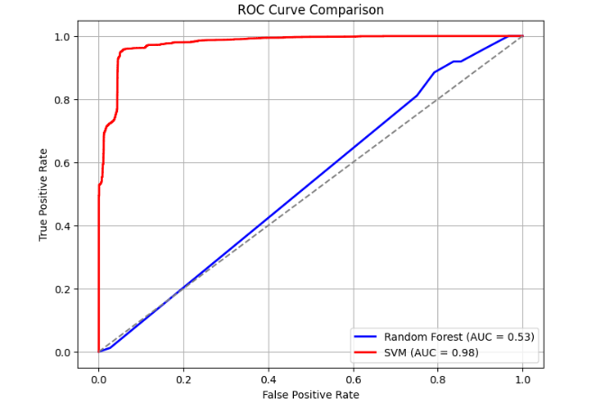
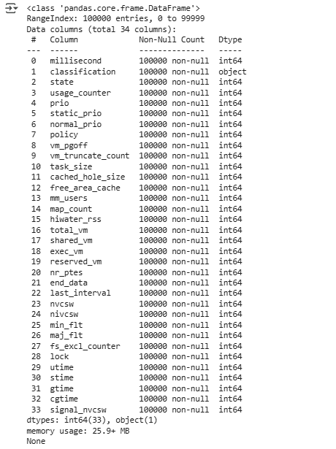
Malware Attacks
Future Prediction
This problem can increase in future: India is now a major target for malware attacks, accounting for 28% of global mobile malware incidents—more than the U.S. and Canada
AI-Powered Threats: Cybercriminals now use AI to create advanced malware that can bypass traditional security systems.
Machine Learning Models: By analyzing patterns, machine learning can improve malware detection and predict attack methods in advance.
[2]
7

Slide 8
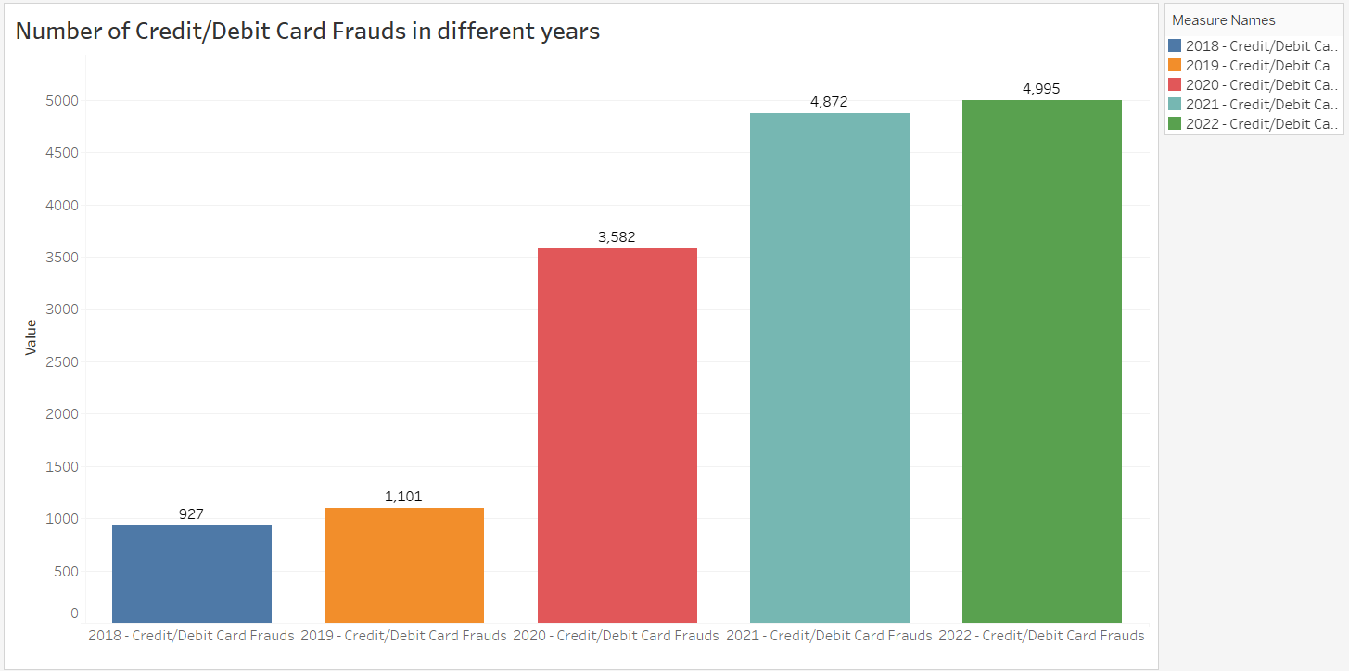
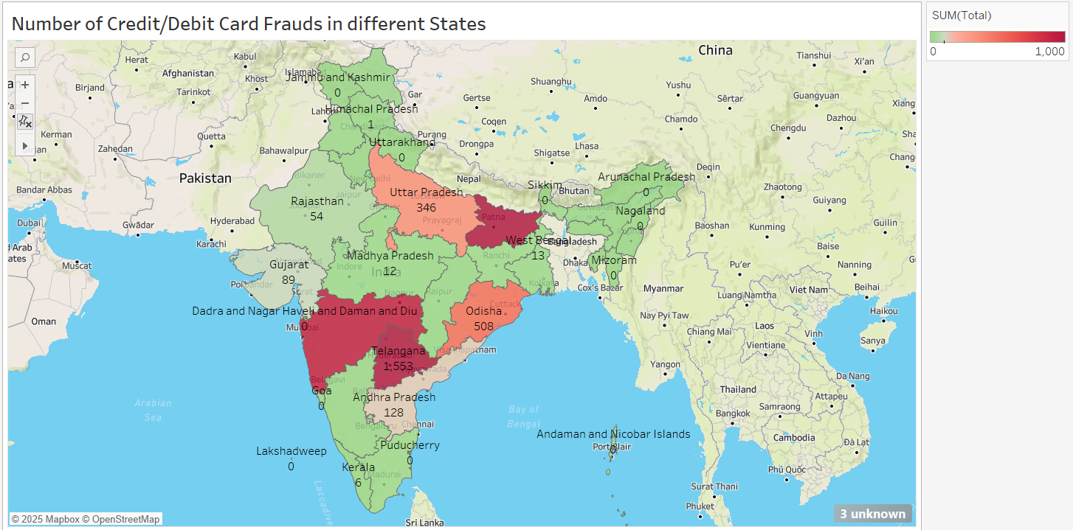
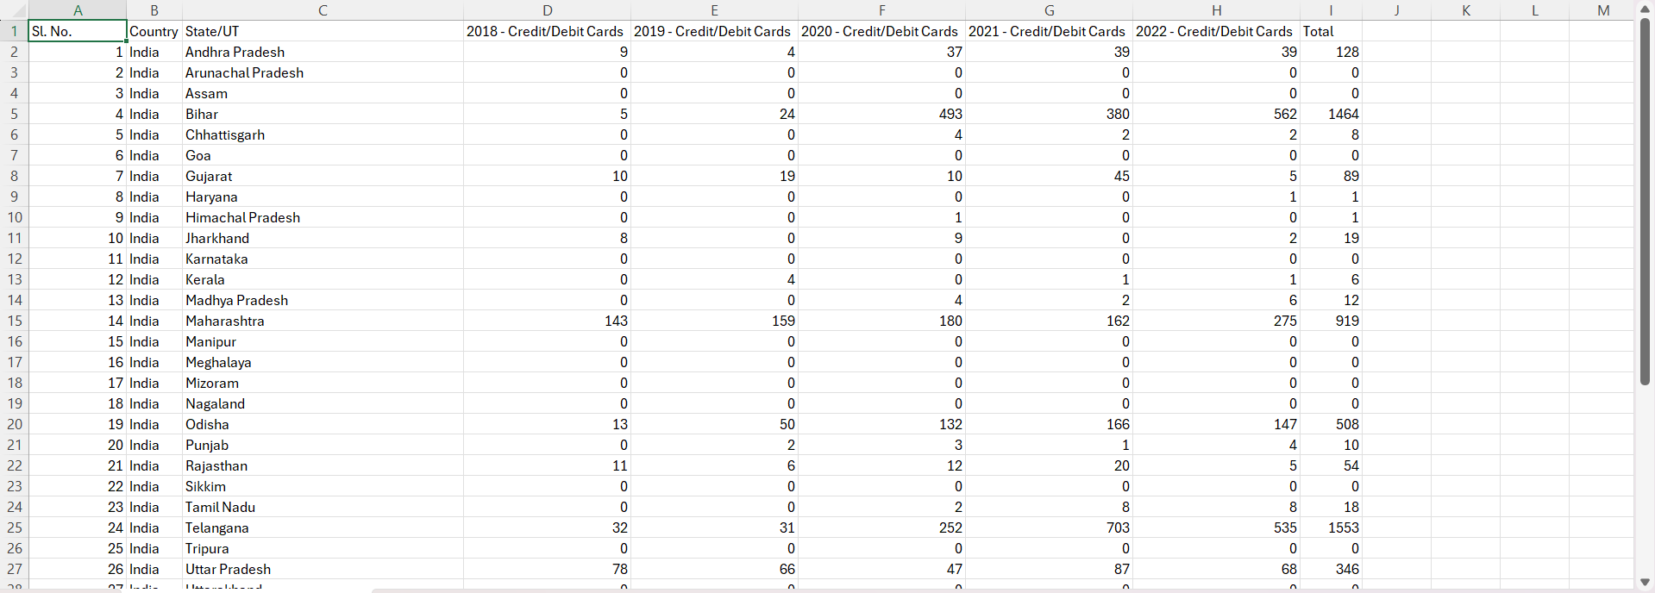
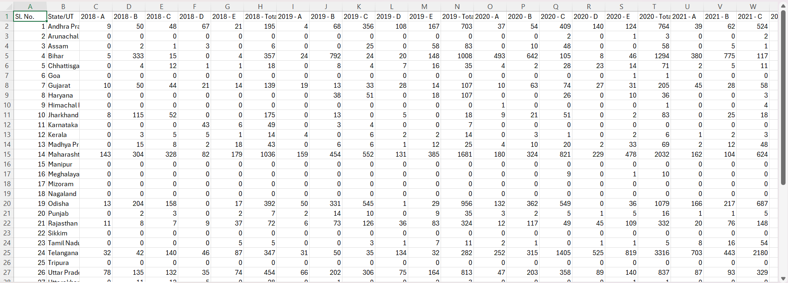
Credit/Debit Card Frauds
01
04
Data overview
Reasons
Duplicate Application Fraud
Social Engineering Fraud
Data Breaches
Rogue Automatic Payments
02
History of Credit/Debit Card Frauds
05
Future Prediction
03
Major Incident
With digital transactions increasing, credit and debit card fraud has also surged in India.
Predictive Insights
Data Analytics
Machine Learning Algorithms
2016 Debit Card Data Breach
2019 Credit and Debit Card Data Breach
8

Slide 9
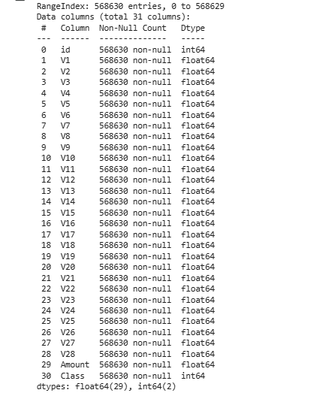
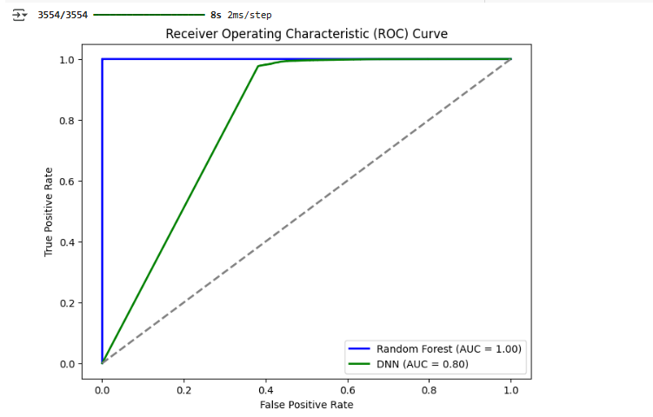
Credit/Debit Card Frauds
9

Slide 10
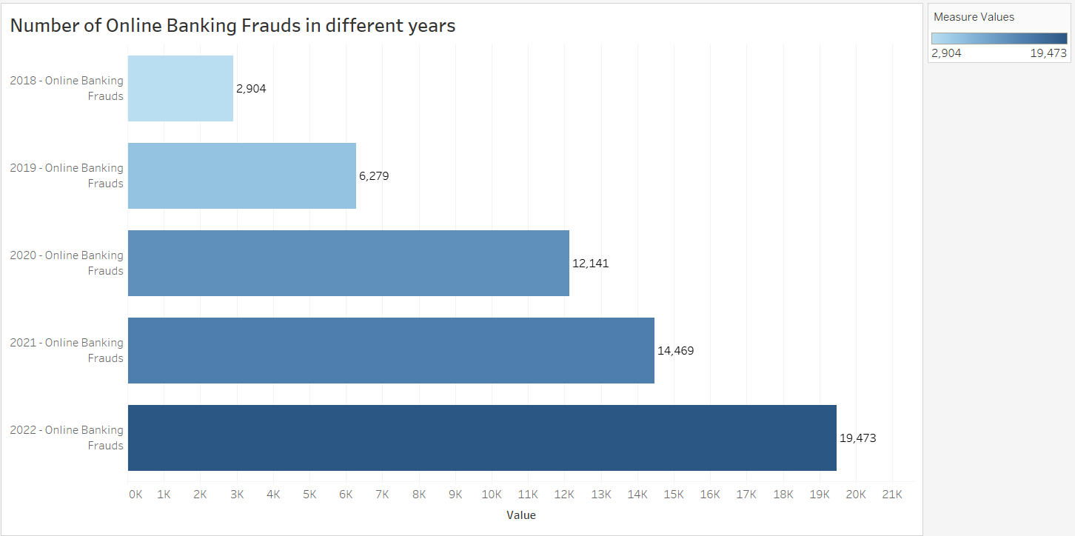
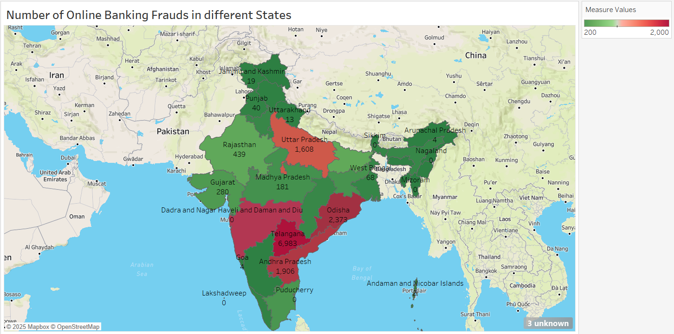
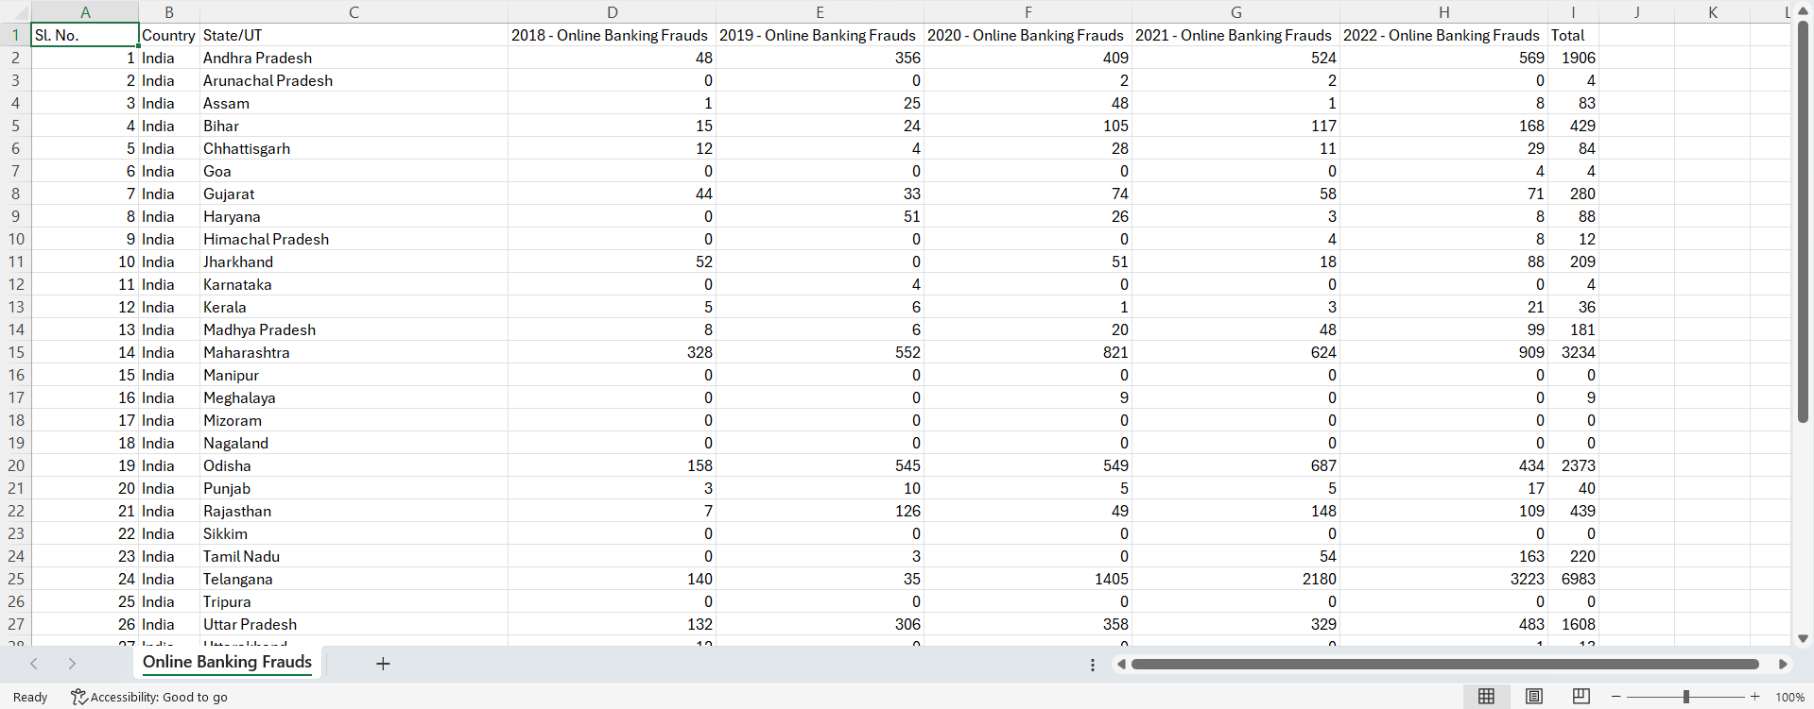
Online Banking Frauds
Data Overview
Future Prediction
Online banking fraud is a major issue, with account takeover attacks making up 55% of all fraud cases in India.
Predictive Insights:
Behavioral Analytics
Predictive Modeling
History of Malware Attacks in India
Major Incident
Surge in Cyber Fraud Cases (Fiscal Year 2024)
Central Bank’s Warning on Rising Digital Frauds
Daily Digital Payment Frauds
Reasons
Insufficient Regulatory Compliance
Weak Cybersecurity Measures
Lack of Consumer Awareness
High Adoption of Digital Payments
10

Slide 11
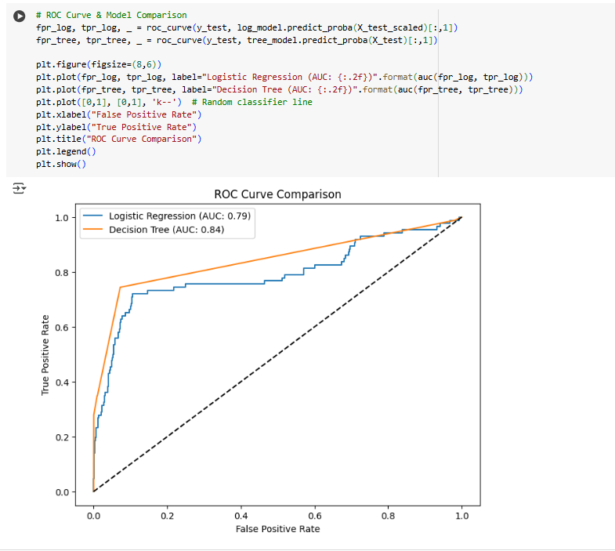
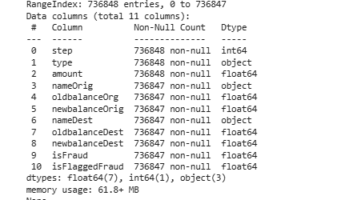
Online Banking Frauds
11

Slide 12
Preventive Measures and Solutions
Enhancing User Awareness and Education
Strengthening Financial Institution Security
Improved Malware Protection
Strengthening Regulatory and Legal Measures
Adoption of Secure Payment Technologies
Collaboration with Cybersecurity Professionals
Government Initiatives for Cybercrime Prevention
Continuous Monitoring and Feedback Loop
12

Slide 13
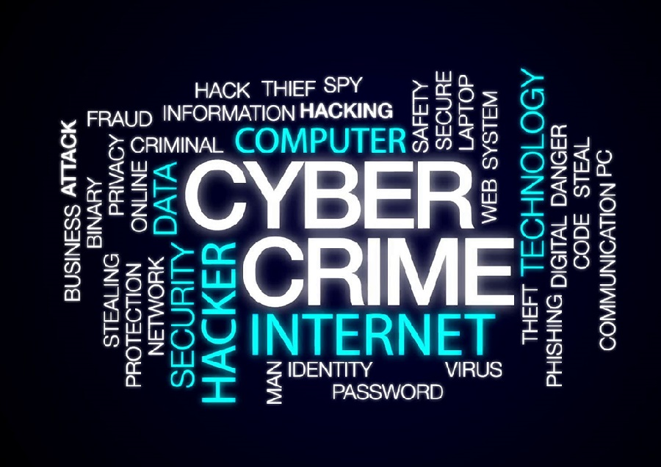
Conclusion
Rising Cybercrime Threat in India
Data-Driven Insights
Key Findings
Future Impact
Continuous Monitoring
13

Slide 14
References
Theme of PPT https://www.free-powerpoint-templates-design.com/qr-code-scanning-powerpoint-templates/
Malware Model Dataset https://www.kaggle.com/datasets/sateeshkumar6289/cicids-2017-dataset
Malware History Dataset https://www.kaggle.com/datasets/teamincribo/cyber-security-attacks
Dataset of history of Credit/Debit Card Frauds and Online Banking Frauds https://www.data.gov.in/resource/stateut-wise-number-cases-registered-under-fraud-cyber-crimes-such-creditdebit-cards-atms
Credit/Debit Card frauds Model Dataset https://www.kaggle.com/datasets/nelgiriyewithana/credit-card-fraud-detection-dataset-2023
Online Banking Frauds Model Dataset https://www.kaggle.com/datasets/rupakroy/online-payments-fraud-detection-dataset
14

Slide 15
Thank You

